Slide 1
AGILE

Slide 2

AGENDA:
What is Agile ?
Agile vs Waterfall. Ex: Obama Care
Agile Principles
Types of Agile
Agile Scrum Team Composition
Agile Scrum Sprint at a glance
Etc…
Q & A

Slide 3
What is AGILE ?

Slide 4
What is Agile?
Software Development methodology.
Iterative Delivery that builds software incrementally instead of trying to deliver at once.
Breaking down work into small pieces(user stories), prioritize and continuously deliver them in 2 week cycle

Slide 5
Waterfall Ex:
Obama Care (HealthCare.gov):
Crashed after 2 hours of launch(5 times more users)
Website design not completed
Users cited dropdown menus being not complete
Insurance companies cited user data not being correct
Log in could not handle much users
President of US pointed out the importance of having technology that works and the necessity of proper testing
Cost 1.7 Billion

Slide 6
Waterfall vs Agile

Slide 7
Agile Principles
Satisfy the customer is the highest priority
Welcome changes even late
Deliver frequently
Work together
Build product around motivated individuals
F2F communication most effective way
Working software is the measure of progress
Continuous attention to technical excellence
Simplicity
Self Organized team
Reflect and Adjust

Slide 8
Types of Agile/Agile Teams
Scrum
Scrumban
Kanban
Extreme Programming (XP)
Lean
Crystal
Etc…

Slide 9

AGILE SCRUM TEAM

Slide 10
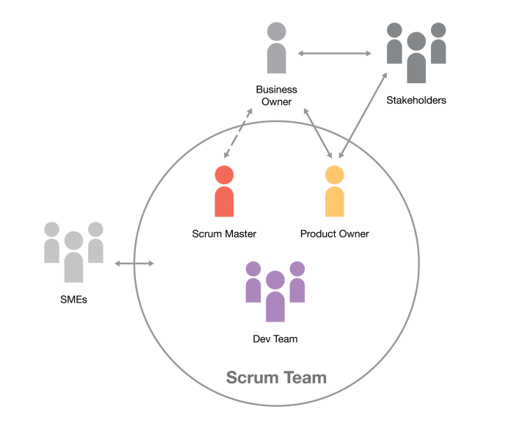
AGILE SCRUM TEAM

Slide 11
Agile Scrum Team
Three Major Role: Product Owner, Scrum Master, and Development Team.
Self-organized and cross-functional team. That can deploy fully functional and tested product within one sprint (two weeks).

Slide 12
Key Characteristics of good Scrum Team
Self-managing
Cross Functional
Co Located
Dedicated (Single project)
Long - Lived

Slide 13
Agile Scrum Sprint

Slide 14
Sprint
A sprint is a short, time-boxed period when a scrum team works to complete a set amount of work.
Sprints are at the very heart of scrum and agile methodologies, and getting sprints right will help your agile team ship better software with fewer headaches.

Slide 15
Agile Srum Ceremonies
Daily Scrum (Daily Stand Up)
Sprint Planning
Spring Demo/Review
Sprint/Backlog Grooming
Sprint Retrospective

Slide 16
ETC …
Backlog
User Story
Team Velocity/Capacity
DoD(Definition of Done)
A/C (Acceptance Criteria)
Pointing in Scrum

Slide 17
Daily Scrum/Stand Up Meeting

Slide 18
Daily Scrum/Stand Up
The Scrum team gets together to define a plan for the day’s work, and identify any blockers
It’s not a status update
Bring up any obstacles or blockers the team is having. The Scrum Master is responsible for clearing these roadblocks for the Development Team so they can focus on delivering the work identified in Sprint Planning.

Slide 19
Daily Scrum/Stand Up
Briefly answer these questions:
What did you do yesterday?
What will you do today?
Are there any impediments in the way?

Slide 20
Daily Scrum/Stand Up
It lasts for 5-15 min
Everyday, except the days when other ceremonies are scheduled
Who is attending:
Scrum Team
Anyone who wants to join

Slide 21
Sprint/Backlog Grooming

Slide 22
Sprint/Backlog Grooming
When the Scrum team reviews items on the Backlog
To ensure:
The backlog contains the appropriate user stories
That they are prioritized
That they are well defined
That the stories at the top of the backlog are ready for delivery or work on
This activity occurs close to the end of the sprint

Slide 23
Spring/Backlog Grooming
Activities done in Backlog Grooming :
removing user stories that no longer appear relevant
creating new user stories in response to newly discovered needs
re-assessing the relative priority of stories
assigning estimates to stories which have yet to receive one
correcting estimates in light of newly discovered information
splitting user stories which are high priority but too coarse grained to fit in an upcoming iteration
giving some more information or acceptance criteria to user story

Slide 24
Sprint Demo/Review

Slide 25
Sprint Demo/Review
When the scrum team completes all work during the sprint and demoes or presents to the stakeholders
This allows stakeholders to see things sooner than later and inspect or adapt the product in early stage
This helps development team to get feedbacks sooner than later and do changes to the product in early stage

Slide 26
Sprint Demo/Review
It lasts 30 min to 1 hour
Attendees:
Scrum Team (as presenters)
Steak holders, management, customers, some other team members that are related to project/product

Slide 27
Sprint Retrospective

Slide 28
Sprint Retrospective
When the Scrum team looks back on the work that was completed in the last sprint and identifies items that went well and what could be improved
Opportunity for a team to review the work that they did.
Discuss things that are going well, things that could go better, and some suggestions for changes. Some common questions asked are:
What went well over the last sprint?
What didn’t go so well?
What could we do differently to improve?
Agile is all about constant improvement, and this ceremony is specifically designed to help the scrum team better

Slide 29
Sprint Retrospective
It lasts 30 min to 1 hour
Attendees:
Scrum Team
No others
Agile is all about constant improvement, and this ceremony is specifically designed to help the scrum team better

Slide 30
Sprint Planning

Slide 31
Sprint Planning
Sprint Planning is the scrum ceremony designed to make sure the team is prepared to get the right things done every sprint.
Happens at the beginning of a new sprint
Scrum Team reviews the prioritized Product Backlog.
Team creates a sprint backlog that contains all items they are committing to complete at the end of the sprint.

Slide 32
Sprint Planning
The Product Owner is responsible for having the Product Backlog ready for review before Sprint Planning:
adding acceptance criteria
requirements
necessary details
clarify any questions or assumptions
only the development team will forecast the amount of work they can accomplish during the upcoming sprint

Slide 33
Sprint Planning
It lasts 1 hour to 2 hours
Attendees:
Scrum Team

Slide 34
Story Pointing in Scrum

Slide 35
Pointing in Scrum
Measurement of effort required to implement a user story
In simple terms, it is a number that tells the team about the difficulty level of the story
Difficulty could be related to complexities, risks, time spend and efforts involved

Slide 36
Pointing in Scrum
Commonly used pointing scale types:
1,2,4,8,16
X-Small, Small, Medium, Large, Extra-Large ( known as “T-Shirt Sizing”)
Fibonacci sequence: 1,2,3,5,8,13,21

Slide 37
Capacity

Slide 38
Capacity
Total number of available hours/points for a sprint.
Available hours calculated based on resources planned holiday and company holiday if any.

Slide 39
Velocity
Number of story points delivered/demo in a Sprint is called velocity.
For example, if team planned 30 story point(Business value) worth of user stories in a sprint and able to deliver as planned then team's velocity is 30.
Available hours calculated based on resources planned holiday and company holiday if any
It is an average points that team can deliver

Slide 40
Velocity

Slide 41
Scrum Team Roles and Responsibilities
Product Owner
Scrum Master
Developer/Programmer/Software Engineer
SDET
Manual QA

Slide 42
Product Owner

Slide 43
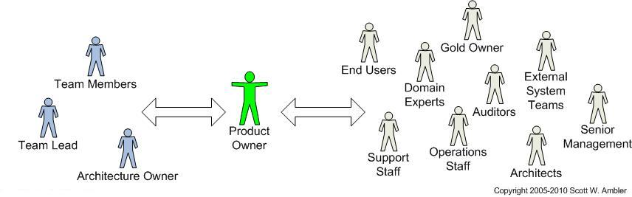
Product Owner

Slide 44
Product Owner
Clear vision of what he or she wishes to build
Because he or she is the decision maker regarding what features the product will have
Pass that vision to the scrum team
First user of the product with a solid understanding of:
end users
the market place
the competition
future trends for the domain
type of system being developed

Slide 45
Product Owner
Even though the PO prioritizes the product backlog
The team selects the amount of work they believe they can do during each sprint
How many sprints will be required
The product owner does not get to say, "We have four sprints left, therefore you must do one-fourth of the product backlog this sprint."
The PO’s job is to motivate the team with a clear picture. Team members know best what they are capable of and so they select which user stories from the top of the product backlog they can commit to delivering during any sprint.
Communication is a large part of the product owner responsibilities
The PO role requires working closely with key stakeholders throughout the organization and beyond, so he or she must be able to communicate different messages to different people about the project at any given time

Slide 46
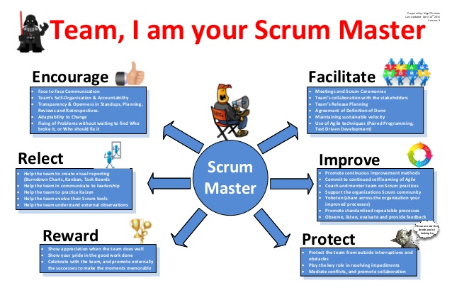
Scum Master

Slide 48
Scrum Master
Servant leaders and coaches for an Agile Team
Help educate the team and ensuring that the Agile process is being followed
Assists in self-organizing and self-managing team achieve its goals
Ex: Make sure no blockers and all dependencies are removed

Slide 49
Scrum Master Responsibilities
Helps Agile Team adopt and apply Agile core values
Supports and reminds team rules
Continuously challenges old norms to improve quality, predictability, flow and velocity
Help team to focus on daily and sprint goals
Helps the team improve and take responsibility for their actions and facilitates the team retrospective
Teaches problem-solving techniques and helps the team become better problem-solvers for themselves
Facilitates all team meetings, including (where applicable) the Daily Stand-up, Sprint Planning, Sprint Review, Sprint Demo and Sprint Retrospective

Slide 50
Scrum Master Responsibilities
Eliminates blocking issues that are beyond the team’s authority or may require support from other teams. The Scrum Master actively addresses these issues so that the team can remain focused on achieving the objectives of the Sprint
Helps the team manage interpersonal conflicts, challenges, and opportunities for growth. Escalates people problems to management where necessary, but only after internal team processes have failed to resolve the issue, helps individuals and teams through personnel changes.
Communicates with upper management and outside stakeholders
Helps protect the team from uncontrolled expansion of work.
Guides the team in establishing estimates and helps the team understand how to estimate Features and Capabilities
Helps the Product Owner in their efforts to manage the backlog and guide the team with priorities and scope

Slide 51

Developer/Programmer

Slide 52
Developer/Programmer
Person, who writes code for the software
Knows all the agile methodologies, tools and organization guidelines
Good communication skills to cooperate with team, as this is, obviously a team work, as well as with customers
Have knowledge in the implementation of the agile process within an organization

Slide 53
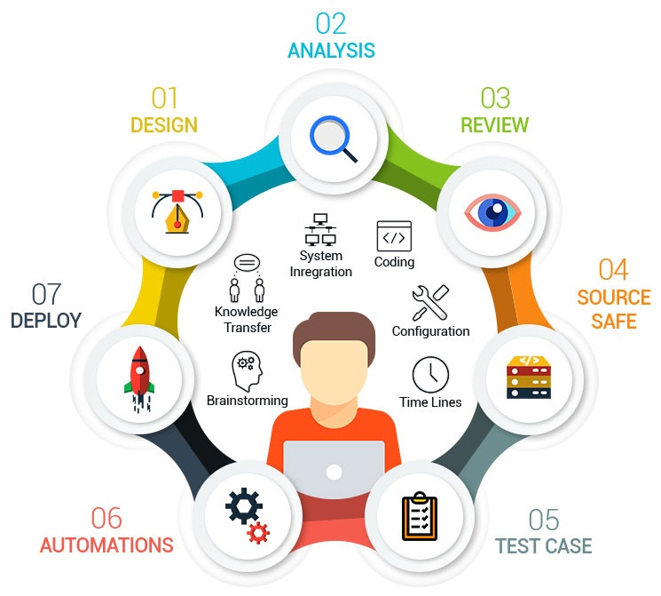
SDET

Slide 54
SDET
Mix of developer as well as tester
SDET:
Engaged into project management
Interacts and understands end user software requirements
Knows product or domain knowledge
Participates in product or software designing
Knows how to code and build test automation tools
***This all in one kind of skill set make the SDET role very unique and high demand in present software industry***

Slide 55
Roles and Responsibilities
SDET is an Engineer:
They know many programming languages, database concepts, participates in product design, data design and user interfaces
Software Testers can code:
They know how to build and test product that can meet user expectations
They know how to test any application deep enough and understand the code which that application or product is built on
They know how to automate the acceptance test by leveraging their coding skill

Slide 56
Roles and Responsibilities
SDET is Customer Advocate:
SDETs voice are very important as they know everything on a product
They have participated in all level of product design, worked with product manager, product development team and end product user
They understand the need of a software product as a whole that’s why they are the best customer advocate

Slide 57
Roles and Responsibilities
Different role from QA or Software Tester:
A Quality Analyst (QA) tests the software only after the development phase is over
But SDETs are active during the development phase and work shoulder to shoulder with developer to understand the code.
QA role is not as technical as an engineer.
SDETs focused on all the steps of software development lifecycle, they prepare test cases and execute them to find bugs in a software product or application and ensures high quality software product release

Slide 58

Manual/Functional QA

Slide 59
Manual/Functional QA
Manual Testers are resources with limited programming skills and they are much focused on black box or functional testing
Manual tester is involved in preparing test cases and executing the test cases usually manually
Usually test user interface or GUI which requires the black box testing and there is no need to write any line of code to test
Usually no need to have domain knowledge

Slide 60
Q & A

Slide 61
Thanks !!!

